Slide 1
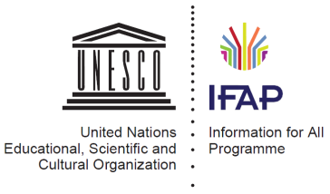
Ethical challenges of the Information Society
Andrejs Vasiļjevs
Dr.Sc.comp., Tilde
UNESCO IFAP Bureau
andrejs@tilde.com
11.06.2013

Slide 2
Key ethical issues of Information Society PAPA (Mason, 1986)
Privacy What information about one's self or one's associations must a person reveal to others, under what conditions and with what safeguards? What things can people keep to themselves and not be forced to reveal to others?
Accuracy Who is responsible for the authenticity, fidelity and accuracy of information? Similarly, who is to be held accountable for errors in information and how is the injured party to be made whole?
Property Who owns information? What are the just and fair prices for its exchange? Who owns the channels, especially the airways, through which information is transmitted? How should access to this scarce resource be allocated?
Accessibility What information does a person or an organization have a right or a privilege to obtain, under what conditions and with what safeguards?

Slide 3
Ethical issues in the information society
Freedom of speech and expression
Abuses of free speech, hate speech, online harassment
Digital divide
Identity, privacy and personal protection
Monitoring and surveillance
Cyber-attacks and cyber-wars
Ownership, intellectual property, copyright, plagiarism, fair sharing and use, voluntary collaboration
Virtual realities, artificial agents
etc.

Slide 4
Internet users per 100 population
2011, Source: Millennium Development Goals Database

Slide 5
Web monitor: ‘Syria has largely disappeared from the Internet’

Slide 6
Identity Theft
Reported incidents, USA:
CY-2010 = 251,089
CY-2011 = 279,226
CY-2012 = 369,132
Source: US Federal Trade Commission

Slide 7
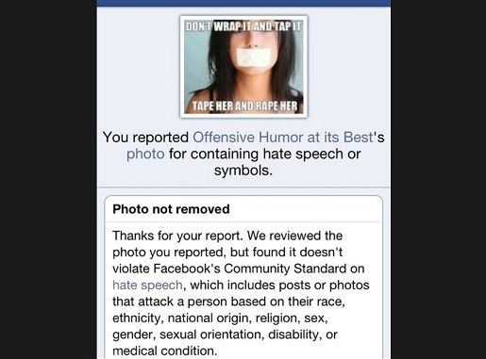

Slide 8
“My computer was arrested before I was.”
Comment by Syrian activist Karim Taymour, who had been caught and arrested by means of online surveillance.
During interrogation he was shown a stack of hundreds of pages of printouts of his Skype chats and files downloaded remotely from his computer hard drive. His torturers clearly knew as much as if they had been with him in his room, or more precisely, in his computer
Source: Reporters without Borders

Slide 9
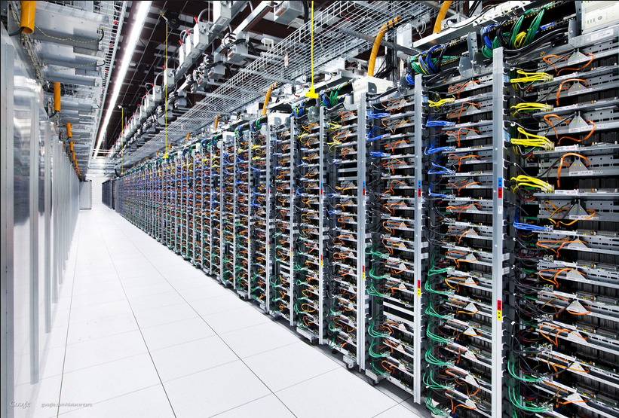
"The idea that government will pass a law which means that there'd be a record kept of every website you visit, who you communicate with on social media sites, that's not going happen.[..] I think that is not either necessary, workable, nor proportionate, so it's not going to happen.“
Comments on London's LBC radio by UK Deputy PM Nick Clegg on the proposed UK online surveillance program
Source

Slide 10
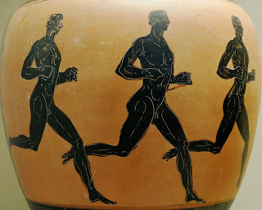
Ethical Aspects

Slide 11
Ethical Aspects
Technologies

Slide 12
Ethical Aspects
Technologies
Legislation

Slide 13
Ethical Aspects
Technologies
Legislation
Conceptualization

Slide 14
World Summit on Information Society
Goal – to facilitate creation of inclusive information (knowledge) society:
To create equal opportunities for all in access and use of information and knowledge
To ensure a balanced development of society, to overcome the digital divide
Focused on people not on technologies
To facilitate reaching of the UN development goals (Millenium Development Goals)

Slide 15
Source: diplomacy.edu

Slide 16
WSIS process
Geneva phase December 2003:
Declaration and Action Plan
Tunis Phase November 2005:
Tunis Commitment
Tunis Agenda for the Information Society

Slide 17
WSIS Action Line C10 Ethical dimensions of the information society
The Information Society should be subject to universally held values and promote the common good and to prevent abusive uses of ICTs.
Take steps to promote respect for peace and to uphold the fundamental values of freedom, equality, solidarity, tolerance, shared responsibility, and respect for nature.
All stakeholders should increase their awareness of the ethical dimension of their use of ICTs.
All actors in the Information Society should promote the common good, protect privacy and personal data and take appropriate actions and preventive measures, as determined by law, against abusive uses of ICTs such as illegal and other acts motivated by racism, racial discrimination, xenophobia, and related intolerance, hatred, violence, all forms of child abuse, including paedophilia and child pornography, and trafficking in, and exploitation of, human beings.
Invite relevant stakeholders, especially the academia, to continue research on ethical dimensions of ICTs.

Slide 18
Role of UNESCO
Develop a basis for informing action that is grounded in respect and observance of human rights.
Identify areas where current policies are insufficient or inadequate, to elaborate these policies or create new in respect to the abovementioned rights.
Assist policy-makers in anticipating the longer-term impacts of current trends as well as the inevitable fast arrival of technological innovations and breakthroughs.
By raising awareness and collectively discussing possible future outcomes and responses, UNESCO empower policy-makers and society to both prepare for, and better cope with technological challenges.

Slide 19
UNESCO IFAP
The Information for All Programme established by the Governments
Enabling everybody to harness opportunities of the Internet and ICTs
Creating equitable societies through better access to information
Develop and implement national information policies and knowledge strategies in a world increasingly using ICTs

Slide 20
IFAP Priority Areas
Information for Development
focuses on the value of information for addressing development issues.
Information Literacy
empowers people in all walks of life to seek, evaluate, use and create information effectively to achieve their personal, social, occupational and educational goal.
Information Preservation strengthening the underlying principles of the Memory of the World Programme, beyond its registers, which serve as catalysts to alert decision makers and the public at large.
Information Ethics cover the ethical, legal and societal aspects of the applications of ICT and derive from the Universal Declaration of Human Rights.
Information Accessibility issues surrounding availability, accessibility and affordability of information, as well as the special needs of people with disabilities.

Slide 21
“Member States and international organisations should recognise and support universal access to the internet as an instrument for promoting the realisation of the human rights as defined in Articles 19 and 27 of the Universal Declaration of Human Rights”
UNESCO recommendation on the ‘Promotion and use of multilingualism and universal access to cyberspace’ adopted by the UNESCO General Conference in 2003

Slide 22
Regional debate in Latin America
UNESCO regional Latin American conference on information ethics, December 6-9, 2006 in Santo Domingo, Dominican Republic
Declaration on the ethical dimensions of the information society (Declaración de Santo Domingo):
to promote peace and respect fundamental values such as liberty, equality, solidarity, tolerance and shared responsibility;
to promote the awareness on the ethical dimension of ICTs;
to avoid abusive use of ICTs and to promote the respect for privacy and personal data;
to promote equal access to information and knowledge;
to promote the responsible use of ICTs;
to improve the access and responsible autonomous use of ICTs by young generations;
to take all measures in order to allow an equitable access to ICTs.

Slide 23
Regional debate in Africa
Africa Information Ethics Conference 5-7 February 2007 in Tshwane, South Africa as part of the implementation of Action Line C10 of the Geneva Plan of Action:
Creation of the Africa Network for Information Ethics (ANIE)
the Tshwane Declaration on Information Ethics in Africa.
e-Government and ethics workshop for African government officials, 23 to 26 February, 2009 in Magaliesburg, South Africa

Slide 24
Regional debate in Asia
Regional Conference for Asia and the Pacific on the Ethical Dimensions of the Information Society, from 12 to 14 March 2008 in Hanoi, Vietnam
statement on information ethics as a contribution to UNESCO's Draft Code of Ethics

Slide 25
Regional debate in Europe
European meeting on ethics and human rights in the information society, Strasbourg, September 13-14, 2007

Slide 26
Code of Ethics for the Information Society
Prepared and proposed by the IFAP Council
Not adapted by the UNESCO General Conference at its 36th session in 2011
Document “UNESCO and the ethical dimensions of the information society” adapted by the Executive Board in October, 2012:
Building multi-stakeholder partnerships to raise awareness of the ethical dimensions of the Information Society and strengthen action in this area
Contribute to the international debate on the ethical dimensions of access to, and use of information
Supporting capacity-building at national level
Foster research and studies in the field of infoethics

Slide 27
"the same rights that people have offline must also be protected online, in particular freedom of expression, regardless of frontiers and through any media"
Resolution of the Human Rights Council of the United Nations, “Promotion, Protection and Enjoyment of Human Rights on the Internet” (5 July 2012)

Slide 28
WSIS+10 Review Process
Goals:
To assess the progress in achieving WSIS Action Plan
To set the goals and implementing instruments after 2015
UNESCO Forum: Towards Knowledge Societies for Peace and Sustainable Development
Paris, UNESCO Head office, February 25-27
Sahalin Conference on Internet and Socio-Cultural Transformations in Information Society September 8-12, Yuzhno-Sakhalinsk
Riga Global Meeting of Experts on the Ethical Aspects of Information Society October 16-17, 2013

Slide 29
Conclusions
It is evident that many ethical issues can and will be understood differently according to different cultural and political frameworks
It is necessary to continue global debate in order to have a common ground for dealing with global issues, presupposing a deep and sustainable analysis and critical discussion of the issues at stake
The ethical challenge is also to promote a global awareness on ethical issues
(Capurro, Britz, 2010)

Slide 30
Let’s make the information society as a society of information ethics!
Thank you

