Slide 1
“Driving a Culture of Open Government using MIL in Latin America” Susana Finquelievich National Council of Scientific and Technological Research - CONICET Universidad de Buenos Aires Argentina
International conference “Media and Information Literacy for Building a Culture of Open Government” Khanty-Mansiysk, Russian Federation June 6-8, 2016

Slide 2
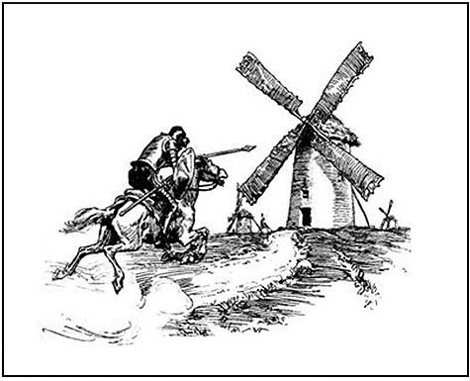
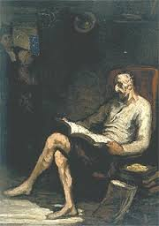
Don Quixote´s mistake

Slide 3
Are we postmodern Don Quixotes easily lost in media´s seduction?
The volume of information available in Knowledge Societies is overwhelming
Our everyday challenge:
To make sense of the massive amount of information we receive
To be able to identify credible sources
To assess the reliability and validity of what we read, to interrogate the authenticity and accuracy of information
To connect this new knowledge with prior learning, and to reinterpret it

Slide 4
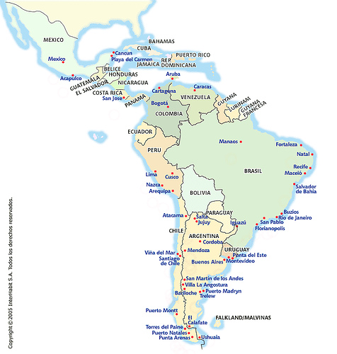
Main questions
Which are citizens demands regarding Open Government (OG)?
How can citizens benefit from OG?
How can MIL contribute to create a culture of OG in Latin America?

Slide 5
It is clear that:
MIL goes far beyond digital literacy
IT IS YET NOT CLEAR THAT:
Open Government goes far beyond e-government

Slide 6
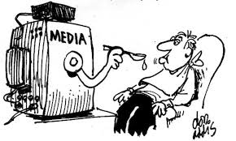
The challenges for MIL in LA: concentration, regulation and sustainability
The major problem: concentration of media control by both the government and the private sector
LA countries need laws and policies to be independent of political and economic interests; media concentration has a negative effect on democracy

Slide 7
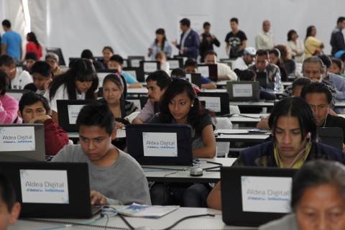
MIL is often confused with digital literacy
The most important challenge in education is e-inclusion
Therefore most LA public policies for education are based mainly on facilitating access to ICT and training teachers and students to use computers and electronic devices in education

Slide 8
Latin American librarians have worked on MIL for many years
Nevertheless, MIL has not been an object of explicit national public policies in the region
During 2015 and 2016 UNESCO has organized meetings in the region to
Enhance the interest on MIL
Plan a study to be implemented in six countries in the region during early 2016
The LAC Media and Information Literacy Forum was held in 2015 in Mexico City

Slide 9
OG involves a transfer of power for government to people
OG refers to three main values:
improve the transparency levels and open data access
b) encourage citizen participation in the design and implementation of public policies
c) stimulate the generation of collaborative spaces between diverse stakeholders

Slide 10
Can OG regain citizens´confidence in LA governments?
Given the governmental corruption scandals that have shaken some Latin American countries in 2015 and 2016 (Argentina, Brazil, Mexico, etc.), it is important for governments to regain trust from their citizens
Open government is a tool to achieve this confidence, which in turn can facilitate administrative performances

Slide 11
The advances
In 2015, the OGP included 15 governments of Latin America and the Caribbean
Some cases (Chile, Colombia, Mexico and Uruguay, large cities in Argentina and Brazil, etc.), have taken a global lead in establishing strategic plans and functioning budgets for the implementation of the UN 2030 Agenda, OG strategies, and statistic modernization initiatives
This includes a better use of digital technology and data openness

Slide 12
HINDERING FACTORS
The main challenge to OG in LAC is corruption
The corrupt employ armies of lawyers, consultants, accountants and bankers to create foreign holding companies registered in places (Panama, Bahamas, the British Virgin Islands…) where no questions are asked about the origin of the wealth
Citizens share a sensation of incredulity and distrust towards their governments.

Slide 13
Lack or insufficiency of information regarding Open Government
Empirical research has shown that most citizens in Latin America ignore that they can use public information through governmental portals
Even if national and local governments display their advances in OG in specialized events, they fail in communicating them to common citizens

Slide 14
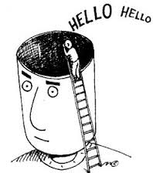
Misuse of the Internet by governmental officials
Although the Internet has great potential to improve government– citizen relations…
… many governments at all levels have not taken full advantage of this potential to improve Web site features to enhance Web-enabled governance through online citizen participation in the policy process

Slide 15
Lack of transparency
In spite of discourses about transparency, many governments do not display genuine information
For example, many local governments display their staff´s salaries in an Excel table. This is no guarantee of true information, as would be the reproduction staff´s salaries receipts
Transparency and access to information help create channels for citizen participation and identify deficiencies in both the public and private sectors that might become entry points for corrupt practices

Slide 16
How can MIL enable the construction of a culture for Open Government?
MIL is addressed to the development of knowledge and to the conscience and practice of media´s users’ rights
MIL helps citizens to Identify attacks to users’ rights, violence, discrimination, etc.
MIL helps the development of citizenship, but also enhances cognitive skills: selection of information, credible sources, analysis of information, interpretation, validation of information critical analysis

Slide 17
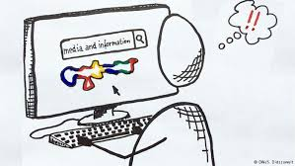
MIL can help Latin American citizens to:
Understand why and how governmental information, as well as media and other information providers are important for the construction of democratic societies and for social and economic development
Identify their own individual and communities´ needs regarding governmental information
Locate, access, interpret, evaluate, and organize information from governments, media, and other information providers

Slide 18
MIL can also help to:
Share, stock, and co-create information
Contribute information to national, regional, and/or local governments
Interact with national, regional, and/or local governments, express themselves, upload content online, and claim the satisfaction of their needs
Claim for the regulation or elimination of concentration of media
Request multilingual information
Participate with the governments in the co-construction of policies and initiatives

Slide 19
Proposals
The starting point for any for OG is to understand who the information users are, their motives and incentives, and the dynamics of the sector in which they operate
These characteristics determine the contents of the information and the vehicles used for disclosing it
Citizen engagement in OG is not an event; it is a process. It requires constant and uninterrupted efforts from citizens’ organizations, the Academia, librarians, the educational sector, governments, and private enterprises, to construct an adequate culture of open information sharing and co-creation

Slide 20
Last but not least
It's necessary for LA countries to improve the articulation and management of MIL programs within each country/ region/city
Diverse programs in various territorial levels, often overlap and suffer from lack of internal articulation
It should be thought long term what the ultimate goals of MIL are -further than the democratization of knowledge- and think lines of action in that way

Slide 21
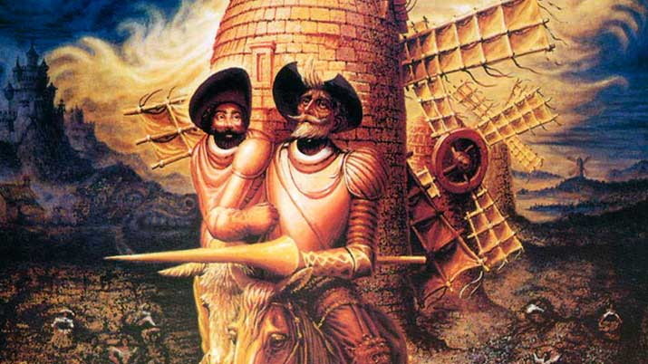
MIL and OG can help us to become lucid Don Quixotes Any questions? sfinquel@gmail.com

